Slide 1


Bankrupty-Prevention
Presentation By
Team No. 3
Lakshmi Vijay
Lakshmi Jayaprakash
Buddharaju Srujan Varma
Alisha Kamruddin Shaikh
Shweta Santosh Pardhi
S Krithiga

Slide 2
Business Problem:
The data were collected from the Taiwan Economic Journal for the years 1999 to 2009. Company bankruptcy was defined based on the business regulations of the Taiwan Stock Exchange.
It has 6819 rows and 96 columns.
The values of independent features are numerical and the dependent feature contains Binary value(1/0).
The dataset has broadly contains the ratios between the different financials and some features contain the real values.
INTRODUCTION:
Bankruptcy prediction is always a topical issue. The activities of all business entities are directly or indirectly affected by various external and internal factors that may influence a company in insolvency and lead to bankruptcy. It is important to find a suitable tool to assess the future development of any company in the market.

Slide 3
OOB
OBJECTIVE
The objective of this Capstone Project is to create a model for predicting potential bankruptcy of companies using suitable classification methods, and to evaluate the results of the methods used
Methodology: Machine Learning (ML) Classification Algorithms (Supervised ML Model)
The following procedure we followed to complete the project.
Visualizations
Box Plot
Histogram
Scatter Plot
Model Building
Linear Model

Slide 4
Project Architecture / Project Flow
Project Flow can be defined by the following steps
Data Cleaning
Importing the Packages
Reading the Dataset
EDA
Visualization
Final Dataset after EDA
Model Building
Final Model
Deployment

Slide 5
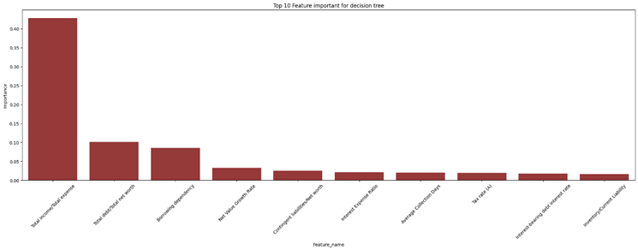
Plots of the Distribution of Top 3 Features (according to decision tree)
Exploratory Data Analysis (EDA)

Slide 6
Overview of Dataset:
It has no ‘NaN’ or ‘Null’ values
It has no duplicate values
‘Bankrupt?’ is a dependent feature.
‘Net income flag’ contains only 1 as a value.
Almost all the features have tailed histogram.
Dependent variable contains 6599 - 0s and 220 - 1s. Hence it is a imbalance dataset.
Inference: There are Total 6819 rows & 96 columns

Slide 7
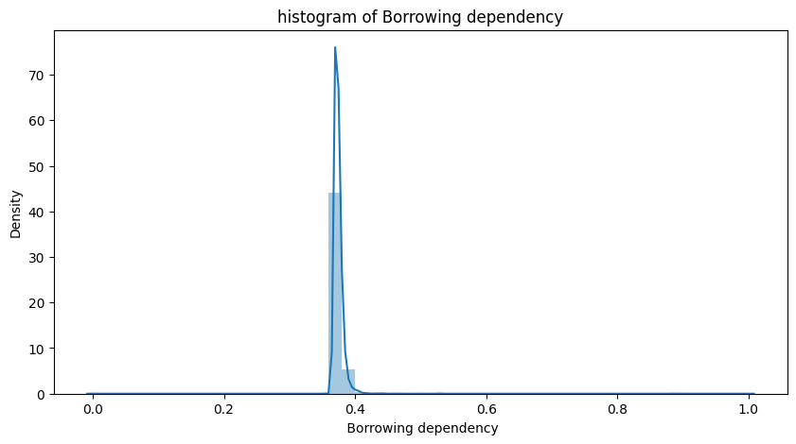
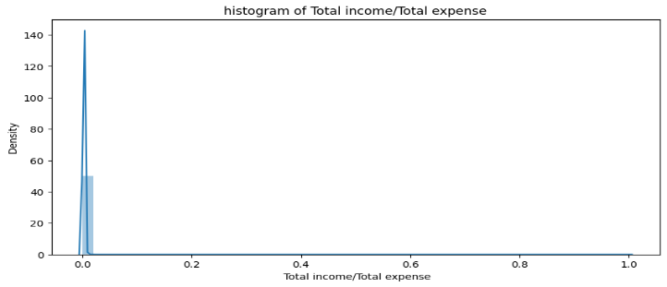
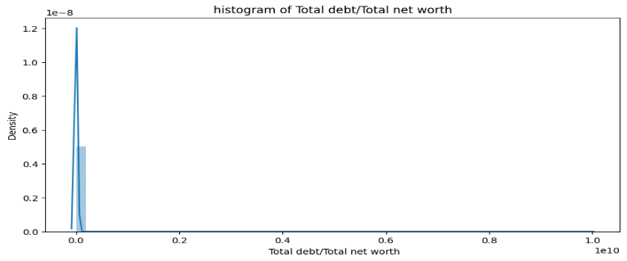
Feature Engineering/Visualization
Visualization is any technique for creating images, diagrams, or animations to communicate a message. Visualization through visual imagery has been an effective way to communicate both abstract and concrete ideas since the dawn of humanity.
HISTOGRAM
From the above plot we can say, All three are tailed histograms

Slide 8
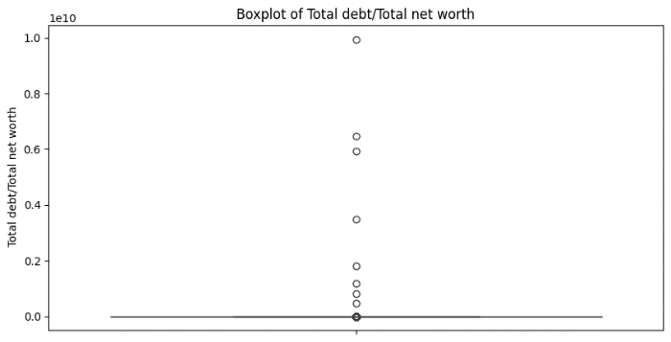
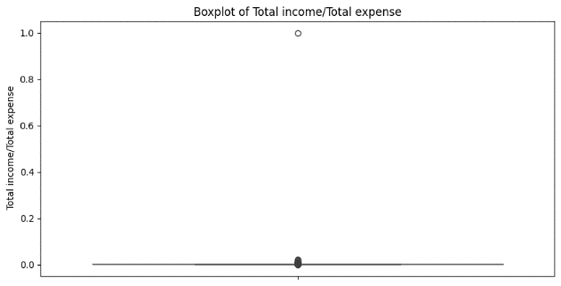
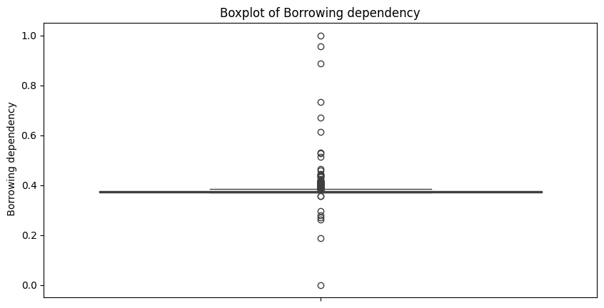
Feature Engineering/Visualization
BOX PLOT
All the three contains outliers.

Slide 9
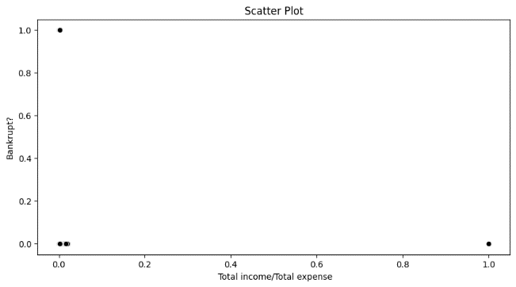
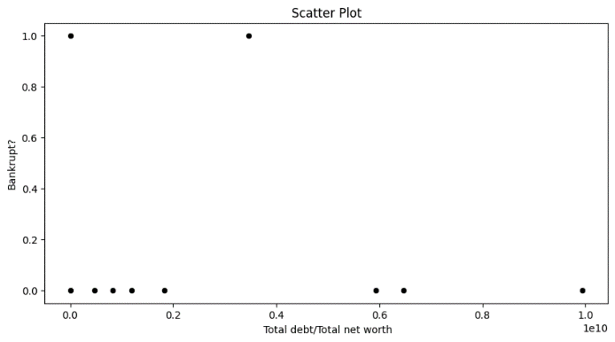
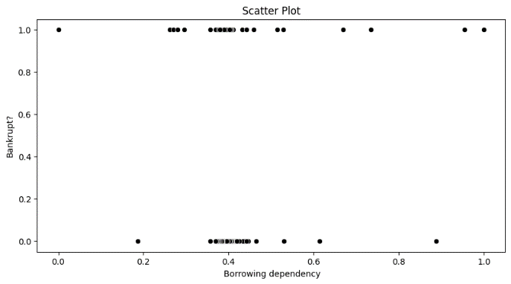
Feature Engineering/Visualization
SCATTER PLOT- top 3 features
Since, our dependent variable is categorical hence scatter plot always contains points on 1 and 0.

Slide 10
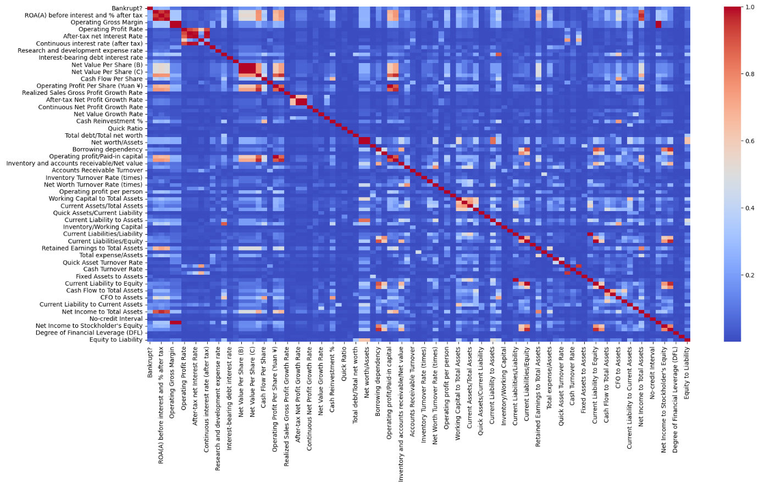
Heat Map
A heatmap is a graphical representation of data that uses a system of color coding to represent different values. Heatmaps are used in various forms of analytics but are most commonly used to show user behavior on specific web pages or webpage templates
With the help of heatmap we can easily see that there so many features which are highly correlated

Slide 11
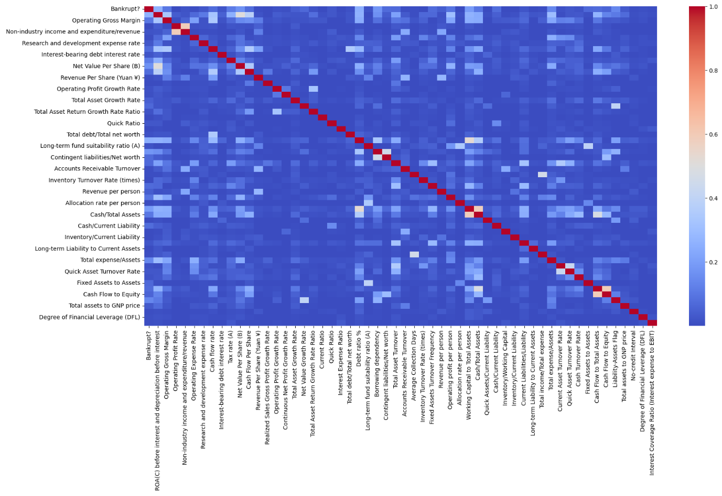
Heat Map
After removing some features, then our dataset is now contains less correlated features.

Slide 12
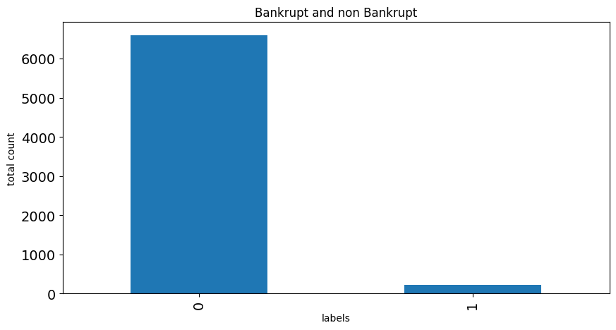
Dependent Variable
From this bar graph, we can see that our dataset is highly imbalanced. So, we need to do some resampling technique.

Slide 13
Model Building
In regression analysis, model building is the process of developing a probabilistic model that best describes the relationship between the dependent and independent variables. The major issues are finding the proper form (linear or curvilinear) of the relationship and selecting which independent variables…
Classification Algorithms Implementation
Logistic Regression: Logistic regression is a supervised machine learning algorithm used for classification tasks where the goal is to predict the probability that an instance belongs to a given class or not.
Naive bayes classification: Naïve Bayes Classifier is one of the simple and most effective Classification algorithms which helps in building the fast machine learning models that can make quick predictions.
K-nearest neighbour classification: KNN is a simple algorithm that stores all the available cases and classifies the new data or case based on a similarity measure. It is mostly used to classifies a data point based on how its neighbors are classified.
Gradient Boosting Machine (GBM) classification: GBM is a popular boosting algorithm in machine learning used for classification and regression tasks. Boosting is one kind of ensemble Learning method which trains the model sequentially and each new model tries to correct the previous model.
Decision Tree: a tree diagram which is used for making decisions in business or computer programming and in which the branches represent choices with associated risks, costs, results, or probabilities.
Random Forest: Random forest is a commonly-used machine learning algorithm, which combines the output of multiple decision trees to reach a single result. Its ease of use and flexibility have fueled its adoption, as it handles both classification and regression problems.

Slide 14
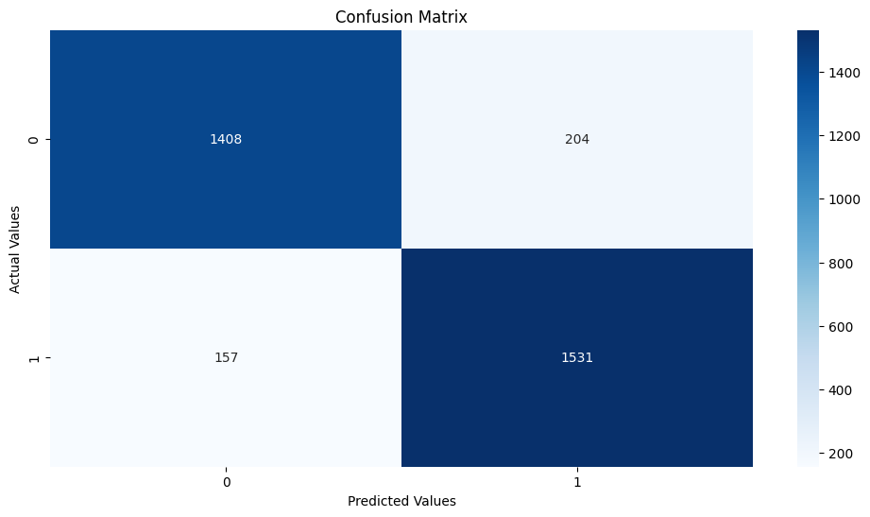
1. Logistic Regression
The Accuracy for Training Set is 88.95736512426753
The Accuracy for Test Set is 89.06060606060606
ROCAUC score: 0.8902198264203309

Slide 15
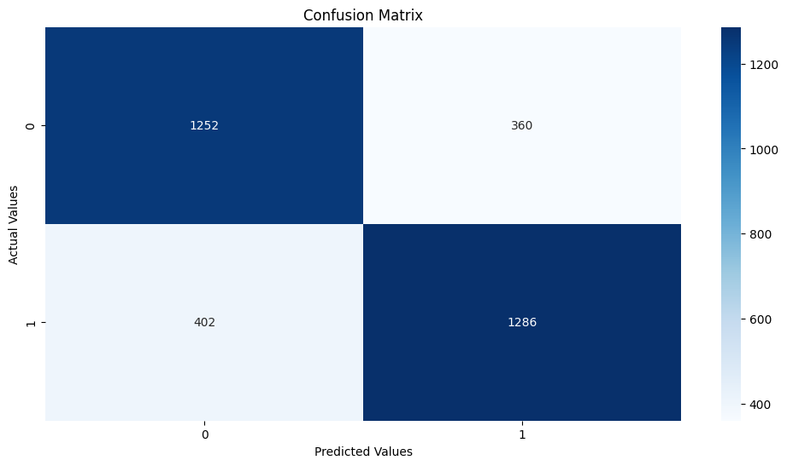
2. Naive bayes Classifier
The Accuracy for Training Set is 76.50030309153364
The Accuracy for Test Set is 76.9090909090909
ROCAUC score on test set: 0.7692616395987439

Slide 16
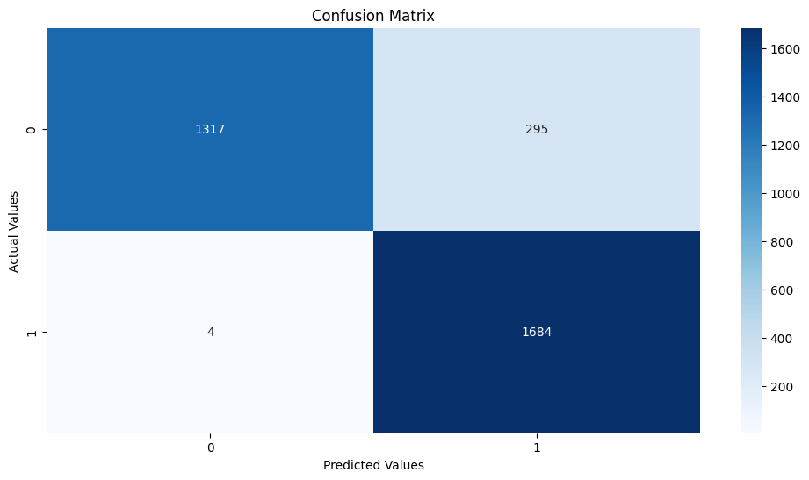
3. K-Nearest Neighbor Classification
The Accuracy for Training Set is 99.72994946706682
The Accuracy for Test Set is 90.93939393939394
ROCAUC score on test set: 0.9073139251819882

Slide 17

4. Gradient Boosting Classifier
The Accuracy for Training Set is 100.0
The Accuracy for Test Set is 98.66666666666667
ROCAUC score on test set: 0.9864501134853527

Slide 18

5. Decision Tree Classifier
The Accuracy for Training Set is 100.0
The Accuracy for Test Set is 95.69696969696969
ROCAUC score on test set: 0.9566535933108322

Slide 19

6.Random Forest classifier
The Accuracy for Training Set is 100.0
The Accuracy for Test Set is 98.15151515151516
ROCAUC score on test set: 0.9812050909646843

Slide 20
Deployment: Software deployment is the process of making software available to be used on a system by users and other programs. You might deploy software to create a backup copy of the software, to move the software to another system, or to create another SMP/E-serviceable copy for installing service or other products.
Deployment
Model Cross Validation:
Logistic Regression:
Cross-validation scores:[0.50795455,0.59015152,0.55568182,0.63243653, 0.64304661] & Mean CV accuracy: 0.5858542032679963
Naive Bayes:
Cross-validation scores:[0.7405303,0.74318182,0.78030303, 0.76506252,0.80030315] & Mean CV accuracy: 0.7658761640658193
K-Nearest Neighbours:
Cross-validation scores: [0.84962121 0.87765152 0.91856061 0.93406593 0.92118227] & Mean CV accuracy: 0.900216306681824

Slide 21
Deployment
Model Cross Validation:
Gradient Boosting:
Cross-validation scores:[0.9155303,0.91439394,0.96818182,0.96892762,0.97423266] & Mean CV accuracy: 0.9482532697187869
Decision Tree:
Cross-validation scores:[0.92083333,0.91174242,0.96439394,0.97006442,0.96703297]& Mean CV accuracy: 0.9468134164685889
Random Forest:
Cross-validation scores:[0.95909091,0.95719697,0.98598485,0.98711633,0.98938992]& Mean CV accuracy: 0.9757557959282097

Slide 22
Challenges Faced?
We faced the challenges regarding to set up the pipeline for the deployment.
We faced the challenges to determine the best accuracy for the model building.
We faced the challenges to visualize the model building to represent the box plot and Histogram
How did you overcome?
We used the platform to deploy the code and used the data from the given dataset to get the predicted output.
We resolved the accuracy of the model with the help of training and testing dataset by using the 6 different algoritms .
We used the outliers concept to resolve the boxplot visualisation.

Slide 23
Thank you

